Slide 1
Agile System
Intrusion Detection System (IDS)
WEBSCOPE
By:
Saaransh Sharma 500069713 46
Varun Gupta 500066119 66

Slide 2
Abstract View
Intrusion Detection System (IDS) is a security system that acts as a protection layer to the infrastructure. Throughout the years, the IDS technology has grown enormously to keep up with the advancement of computer crime. Since the beginning of the technology in middle 80’s, researches have been conducted to enhance the capability of detecting attacks without jeopardizing (threaten) the network performance. In this paper we hope to provide a critical review of the IDS technology, issues that transpire during its implementation and the limitation in the IDS research endeavors.
Lastly we will proposed future work while exploring maturity of the topic, the extent of discussion, the value and contribution of each research to the domain discussed. At the end of this paper, readers would be able to clearly distinguish the gap between each sub-area of research and they would appreciate the importance of these research areas to the industry.

Slide 3
Introduction
As the today’s generation we all knew that the criminal/theft has been occurred in user’s life regarding their data security. We have four agile-manifesto as well as twelve methodology. Through which we have to take certain steps regarding making a strong security for the user’s.
Firstly, individuals and interactions over processes and tools, as we know that intrusion detection system is based on to detect the suspicious activity from the database information. This information will automatically monitor and scan the unauthorized to user information does not allow in our system and there is an administrator to secure our database to add security to secure the database example, Administrator ID, Password, etc. Tools like IDS, sensor, alert repository, login, security admin this are used to secure our database.
Secondly, working software over comprehensive documentation, which means the documentation types that the team produces and its scope depend on the software development approach that was chosen.
Here we are going to use "Scrum Model as it’s the latest methodology of agile system – Scrum world, instead of providing complete, detailed descriptions of how everything is to be done on a project, much of it is left up to the Scrum software development team. This is because the team will know best how to solve the problem they are presented."
Thirdly, Customer Collaboration over contract negotiation, when the customer and the project manager — or another project team representative — negotiate contract details. When the customer and the project manager negotiate changes to the contract. When the project team delivers a completed product to the customer. If the product doesn’t meet customer expectations, the project manager and the customer negotiate additional changes to the contract. And lastly we have, responding to change over following a plan, to adaptive planning approach. In this approach, planning is an ongoing activity throughout the execution of the entire project, occurring in small increments as the reality of project execution unfolds.

Slide 4
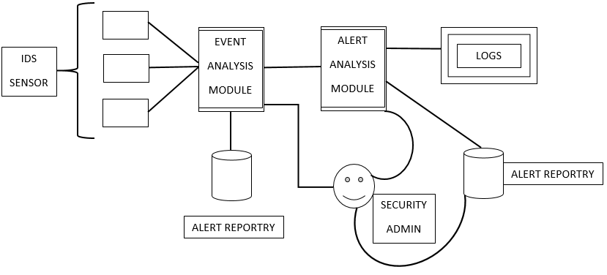
Objective of our Project

Slide 5
Methodology
The Scrum Development Methodology can be applied to nearly any project. This process is suited for development projects that are rapidly changing or highly emergent requirements. The Scrum software development model begins with a brief planning, meeting and concludes with a final review. This development methodology is used for speedy development of software which includes a series of iterations to create required software. It is an ideal methodology because it easily brings on track even the slowest progressing projects.
Advantages of Scrum Development:
In this methodology, decision-making is entirely in the hands of the teams
This methodology enables project’s where the business requirements documentation is not considered very significant for the successful development
It is a lightly controlled method which totally empathizes on frequent updating of the progress, therefore, project development steps is visible in this method
A daily meeting easily helps the developer to make it possible to measure individual productivity. This leads to the improvement in the productivity of each of the team members
Disadvantages of Scrum Development:
This kind of development model is suffered if the estimating project costs and time will not be accurate
It is good for small, fast moving projects but not suitable for large size projects
This methodology needs experienced team members only. If the team consists of people who are novices, the project cannot be completed within exact time frame

Slide 6
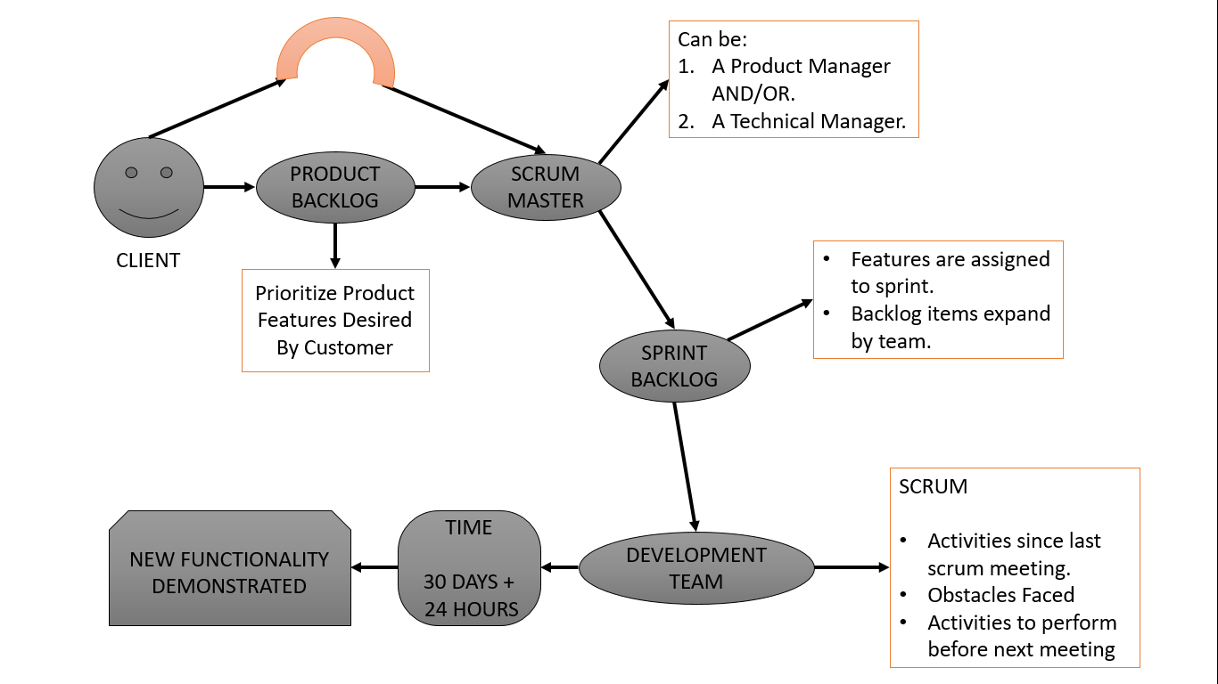

Slide 7
A Scrum Board is a physical or virtual space that represent the scope of current sprint and its status. The current scopes are broken down into executable tasks during sprint planning. A Scrum board mostly have the stories and its associated tasks. This boards are often called as task board as well.
Its also called as Sprint Board or Task Board

Slide 8
Sprint (Story Travel)
Backlog or New : When a Story created for the first time in product backlog it use to have this status.
Groomed or Defined or Ready or Refined : When a Story is passed the Grooming session and become ready (as per the definition of ready) to pick for the future sprint.
In-Progress or Committed : When a story is committed for a sprint, and the sprint is started.
Completed or Resolved : When the construction of the story is completed and ready for review. Means the functionality of the story is analyzed, developed, tested and meets the definition of done.
Accepted or Done or Verified : This use to be the final state of the story workflow. where the story get verified by the product owner by checking the expected functionality is implemented and its meeting the acceptance criteria.
Task
To-Do : Task execution is yet not started.
In-Progress : Task execution is in Progress.
Done : Task executed.

Slide 9
What, How & Why (SCRUM)
We will initialize the client needs on that concept we would check the scope and benefit of the project. Planning to be scheduled for a perfect prototype. Requirements for designing a perfect prototype should be discussed in development team and the implement the product and after completion of the product we need to maintain the software for particular time and then disposition our final project/product.

Slide 10
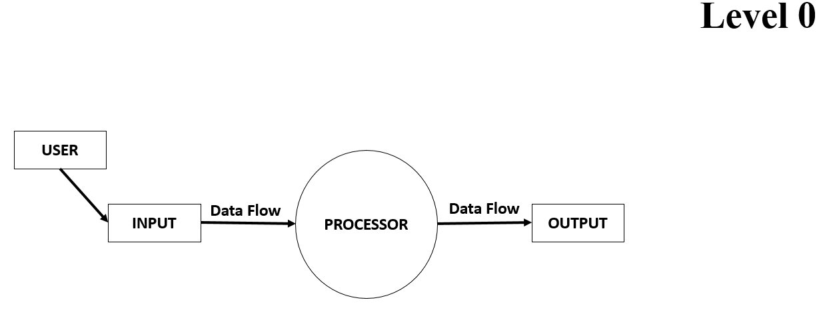
DFD (Data Flow Diagrams)

Slide 11
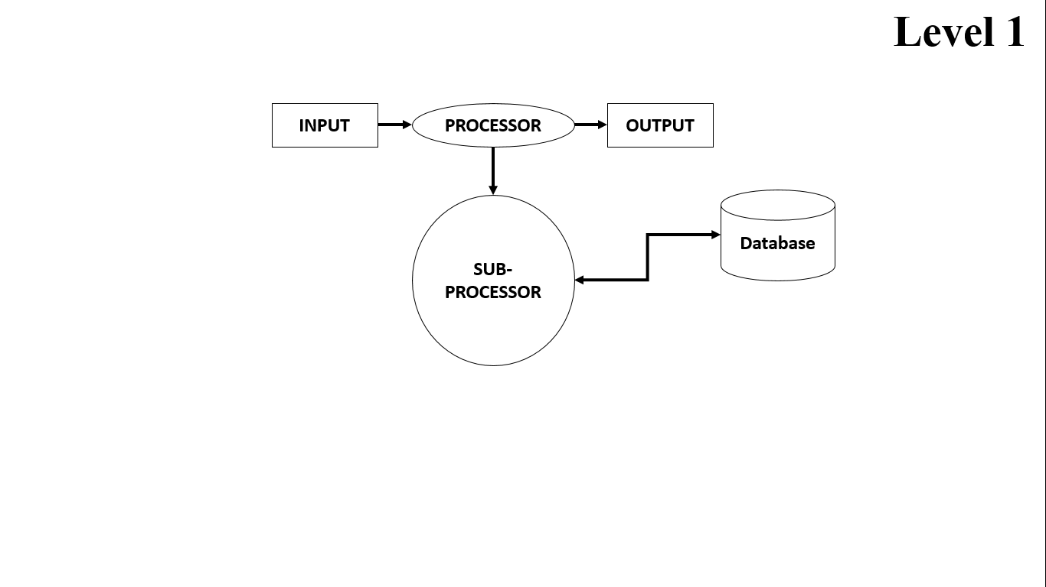
DFD (Data Flow Diagrams)

Slide 12
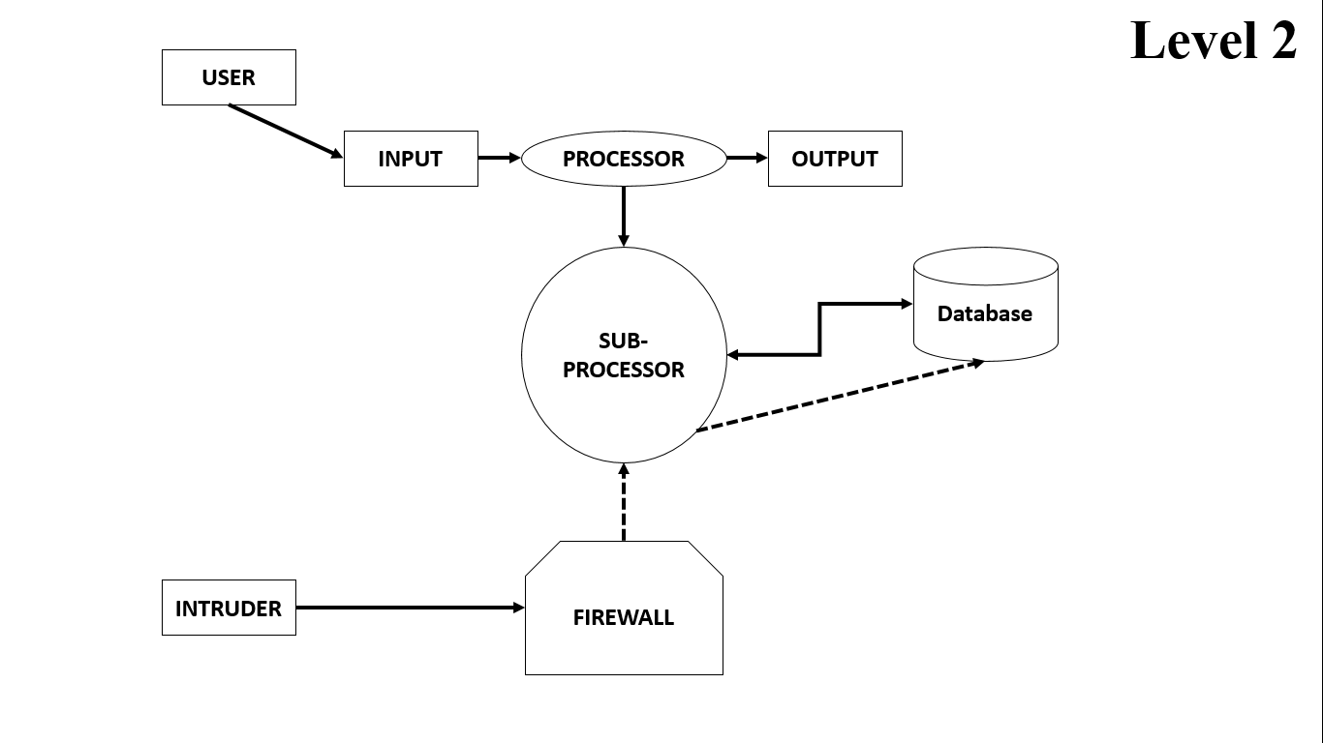
DFD (Data Flow Diagrams)

Slide 13
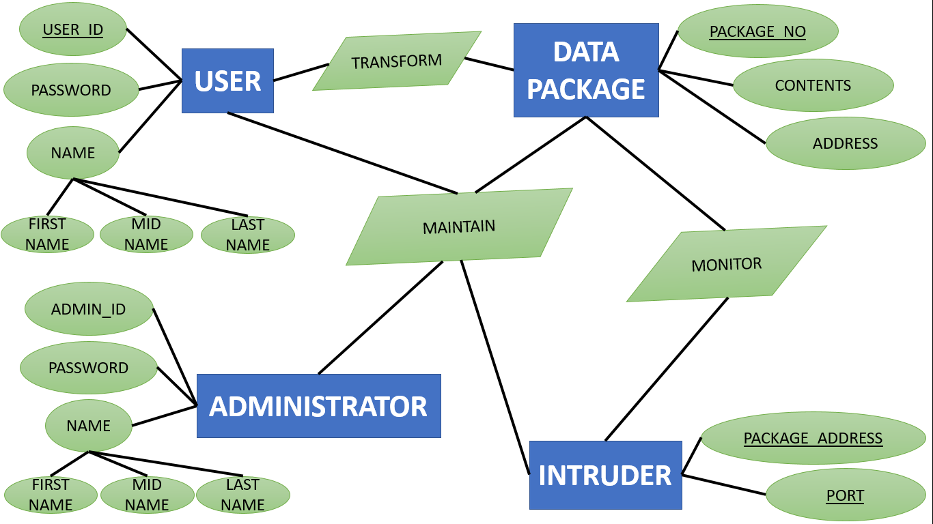
ERD (Entity Relationship Diagrams)

Slide 14
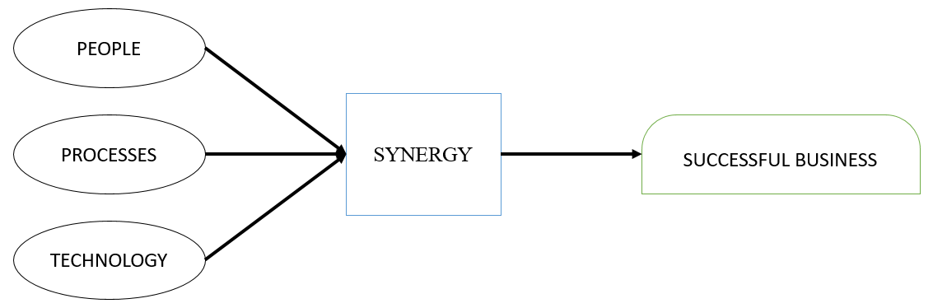
People, Processes & Technology

Slide 15
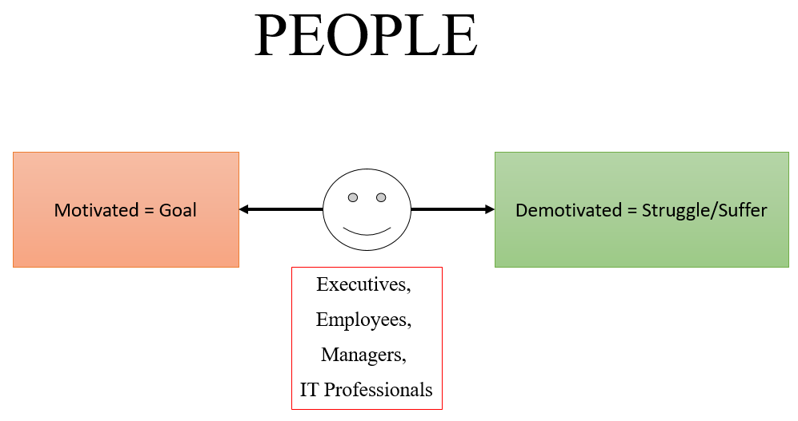

Slide 16
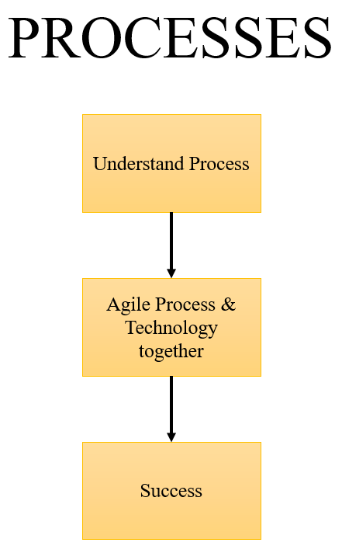

Slide 17
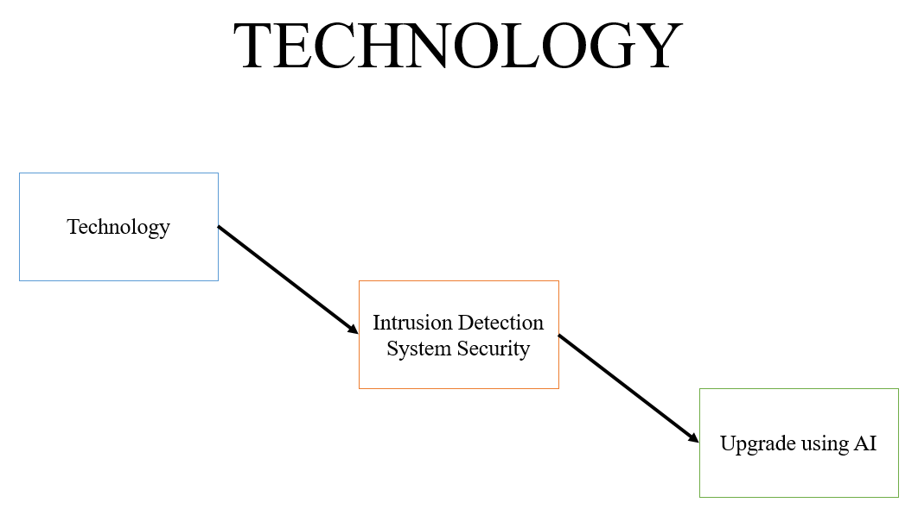

Slide 18
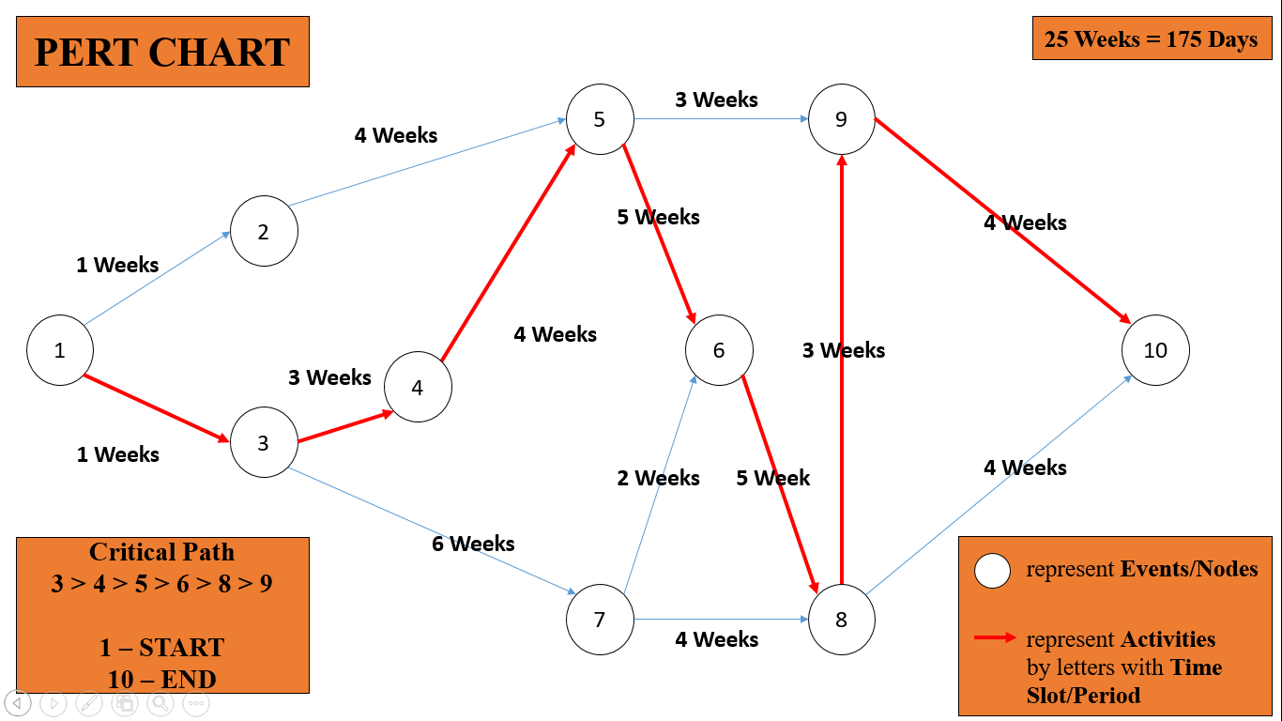

Slide 19
EVENTS/NODES | ACTIVITES |  | Critical Path
 | EVENT occurred in TIME SLOT | 25 WEEKS
1. Start | 1 – START – 3 | WEEK 1 | 1
2. Feasibility Study | 3 – Feasibility Study – 4 | WEEK 3 | 3
3. Requirement Analysis | 4 – Requirement Analysis – 5 | WEEK 4 | 4
4. Design | 5 – Design – 6 | WEEK 5 | 5
5. Coding/Algorithm | 6 – Coding/Algorithm – 8 | WEEK 5 | 6
6. Testing | 8 – Testing – 9 | WEEK 3 | 8
7. Maintenance | 9 – End – 10 | WEEK 4 | 9, 10

Slide 20
TASK NAME | DURATION | START DATE | END DATE
1. Feasibility study | 3 WEEKS | 8/1/2020 | 28/01/2020
Technical Feasibility | 1 WEEK | 8/1/2020 | 14/01/2020
Economic Feasibility | 1 WEEK | 15/01/2020 | 21/01/2021
Behavior Feasibility | 1 WEEK | 22/01/2021 | 28/01/2020
2. Requirement Analysis | 4 WEEKS | 29/01/2020 | 25/02/2020
Requirement Gathering | 1 WEEK | 29/01/2020 | 4/2/2020
Group Interaction | 2 WEEK | 5/2/2020 | 18/02/2020
Analysis | 1 WEEK | 19/02/2020 | 25/02/2020
3. UI-Design | 5 WEEKS | 26/02/2020 | 31/03/2020
Firewall | 2.5 WEEK | 26/02/2020 | 14/03/2020
Log Management | 2.5 WEEKS | 15/03/2020 | 31/03/2020
4. Coding / Algorithm | 5 WEEKS | 1/4/2020 | 5/5/2020
Firewall | 2.5 WEEK | 1/4/2020 | 18/04/2020
Log Management | 2.5 WEEKS | 19/04/2020 | 5/5/2020
5. Testing | 3 WEEKS | 6/5/2020 | 26/05/2020
Unit Testing | 1 WEEK | 6/5/2020 | 12/5/2020
Integration Testing | 1 WEEK | 13/05/2020 | 19/05/2020
System Testing | 1 WEEK | 20/05/2020 | 26/05/2020

Slide 21
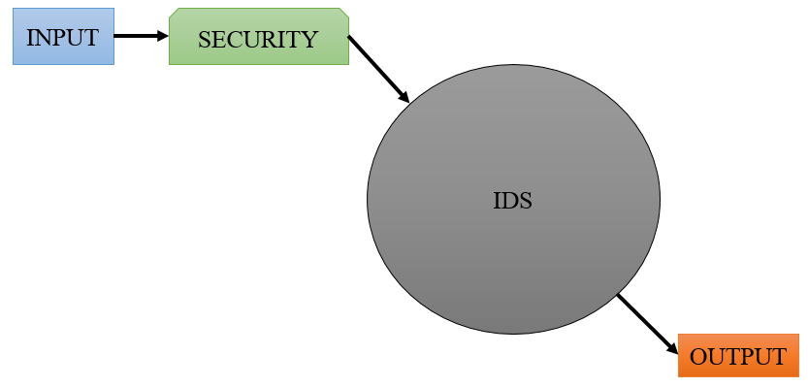
STATE DIAGRAM (PROCESSES)

Slide 22
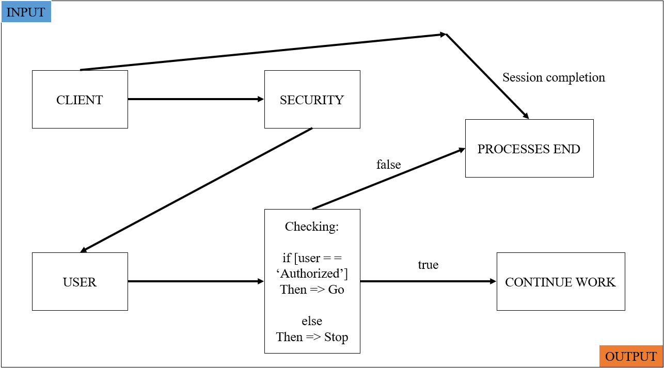
STATE CHART (SUB-PROCESSES)

Slide 23
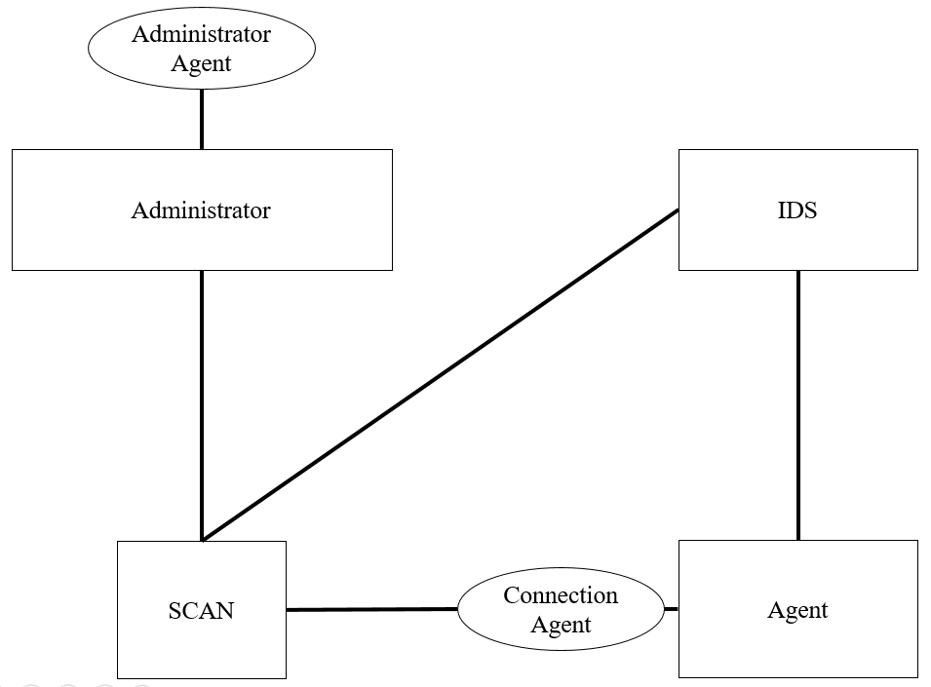
CLASS DIAGRAM

Slide 24
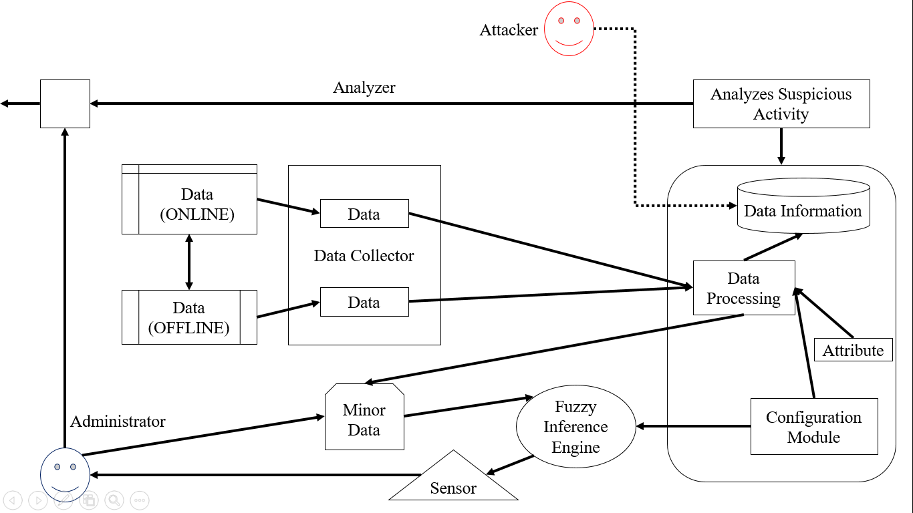
SEQUENCE DIAGRAM

Slide 25
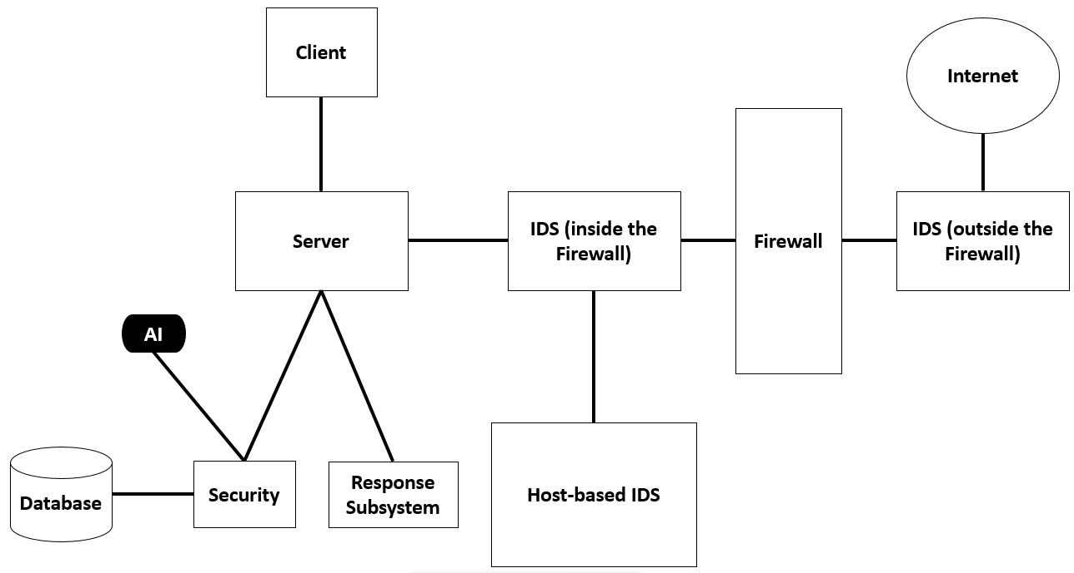
AI using in IDS
“In IDS, using AI for security would help us to recognize the user, so that an intruder couldn’t access to the security breach and our database information is secured.”

Slide 26
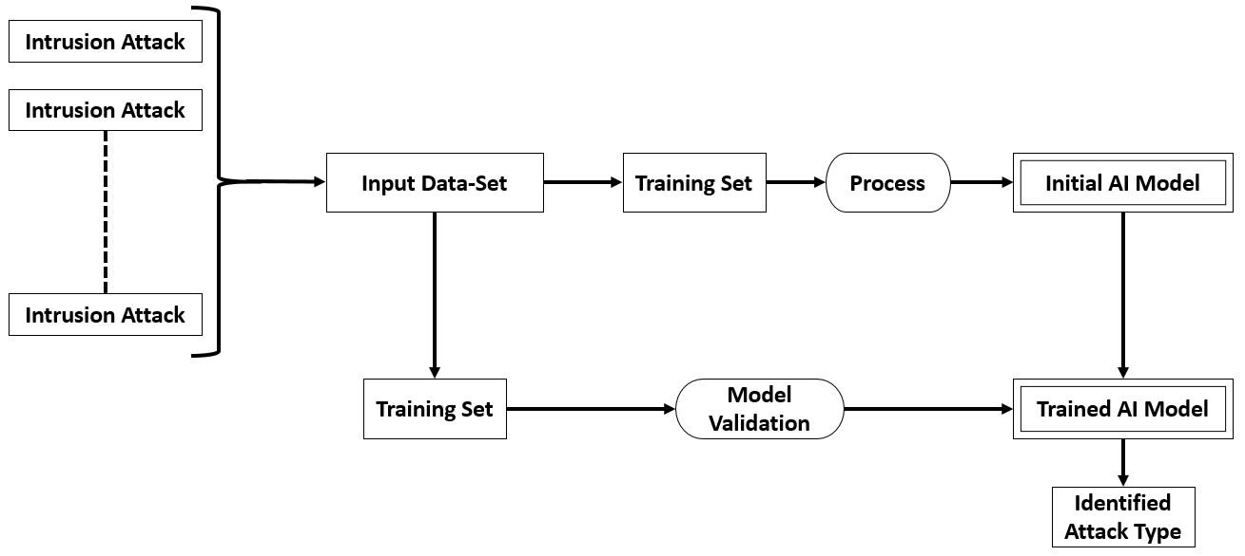
AI based Model in IDS

Slide 27
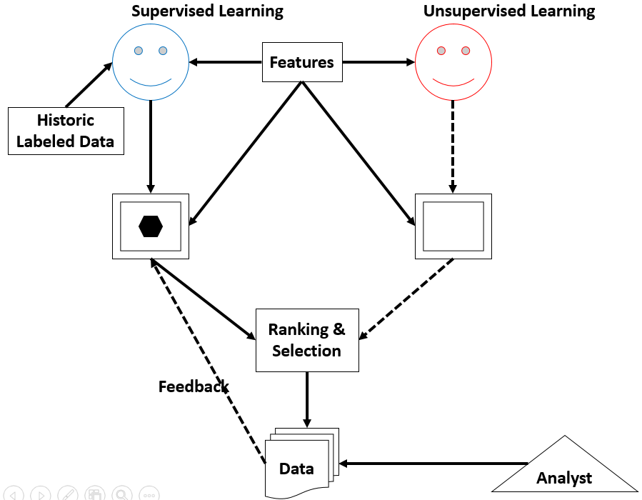
Model AI using IDS

Slide 28
IDS (Algorithm)
Step1: We will start the processing of IDS.
Step2: Taking and input to check if it is “Admin” or not.
Step3: if “Intruder” is found then it will automatically drop the “Admin”.
Step4: if it doesn’t found the “Intruder” then it continues the package.
Step5: “Intruder” is detected then an “Alter” will send the information to “IDS” and then to “administrator” to update the “database information”.
Step6: “Scanner” will send the “IDS information” and keeps the “database secure” from another “Intruders”.
Step7: End of the processes.
START
INPUT - login[], NET[Packet] + DATASETS
if login == "Admin"
then -> Go
if NET[] == "Attack"
then -> DROP[Packet]
else
then -> CONTINUE[Packet]
if NET[] == "Detect"
then -> alert[SENSOR]
else
then -> Acknowledgement
SCAN[SIGNATURE BASE] -> NET[Packet]
else
then -> Stop
END

Slide 29
Thank You

